Slide 1

DEEP SLEEP STUDY

Slide 2
QUESTION:
Do I have above average deep sleep?
(as according to the Sleep Foundation)

Slide 3
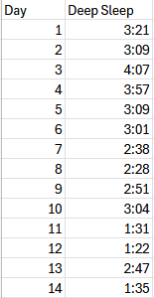

DATA
14 Observations
Variable: Deep Sleep Time
Variable type: Continuous Numeric Collection method: Smart Watch

Slide 4
HYPOTHESIS TESTING
CLAIM: My average time in deep sleep per night is significantly higher than the average given by the Sleep Foundation at two hours. (2:00)
Variable: Deep Sleep
Mean: 2:00 or 2.0 hours

Slide 5
HYPOTHESIS TESTING
STEPS:
Establish a null and alternative hypothesis.
Perform a single sample T-Test.
Acquire the p-value.
Determine if there is enough evidence to reject the null hypothesis.

Slide 6
HYPOTHESIS TESTING
Null Hypothesis:
Mean of my Deep Sleep = Normal Mean of Deep Sleep
Alternative Hypothesis:
Mean of my Deep Sleep >
Normal Mean of Deep Sleep

Slide 7
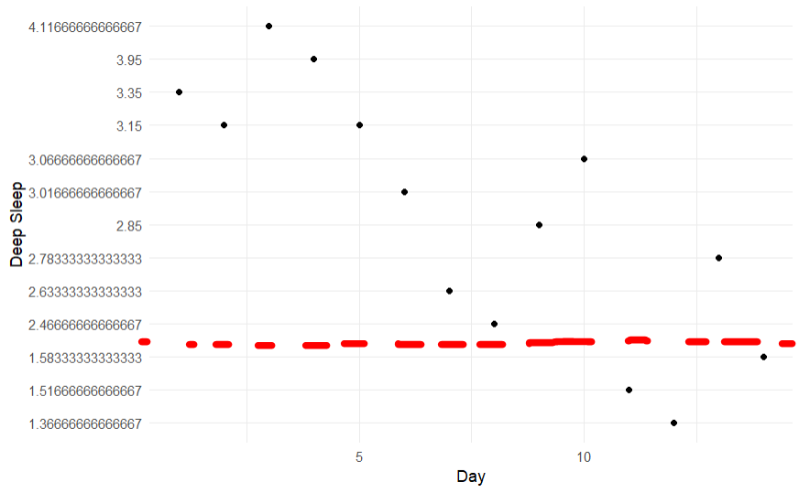
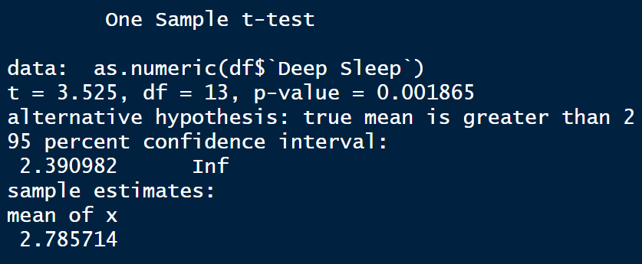
HYPOTHESIS TESTING
After performing the T-Test, the result I got was:
T = 3.525
P-value = 0.001865

Slide 8
CONCLUSION
Since the p-value arrived at of 0.001865 is less than 0.05, we must reject the null hypothesis and accept the alternative hypothesis which says that I have above average Deep Sleep per night.

